Slide 1

Improvi
Go, change the world
RV College of
Engineering
K Preethi(1RV22AI040) ,
B Gayathri(1RV22AI039)
Principles of Management and Economics
(HS251TA)

Slide 2


Go, change the world
RV College of
Engineering

Slide 3

Go, change the world
RV College of
Engineering

Slide 4
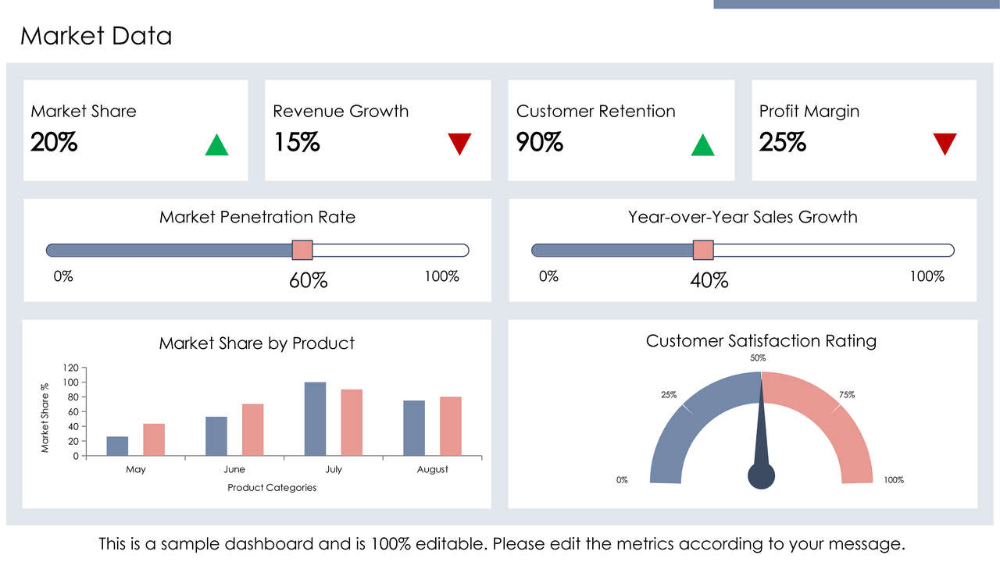
Go, change the world
RV College of
Engineering

Slide 5
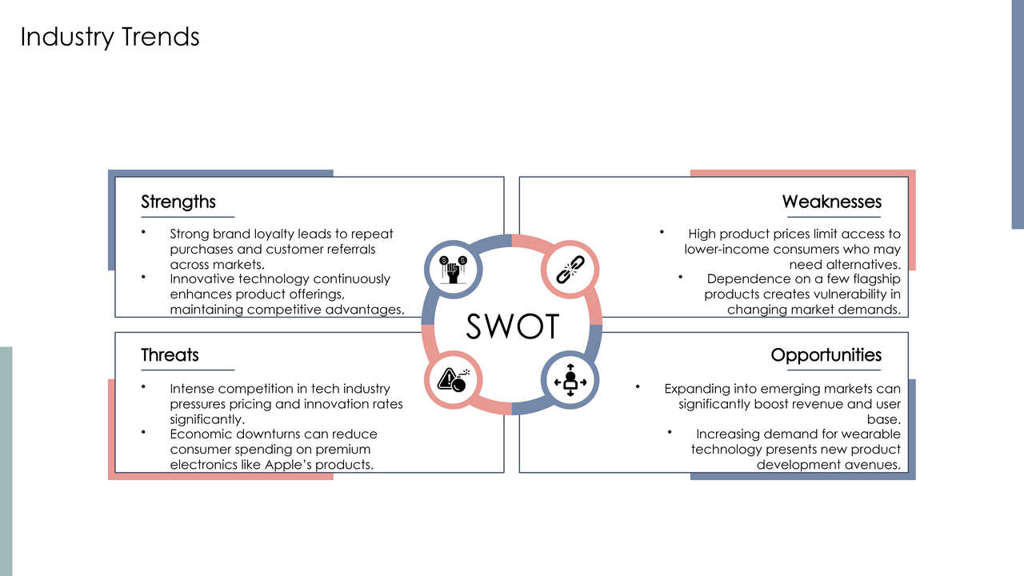
Go, change the world
RV College of
Engineering

Slide 6
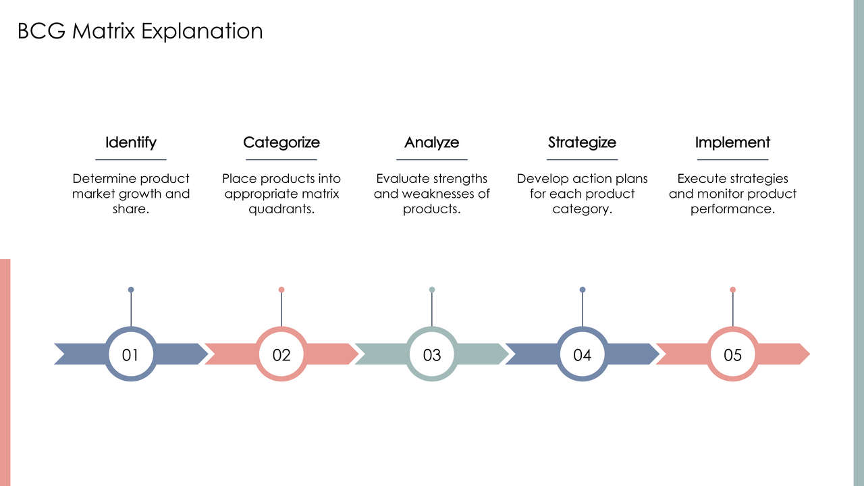
Go, change the world
RV College of
Engineering

Slide 7
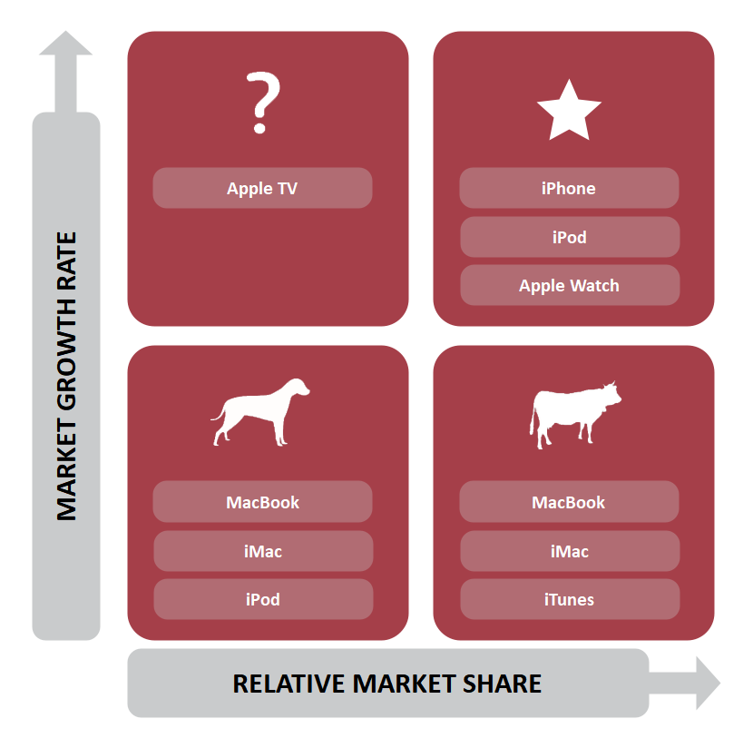
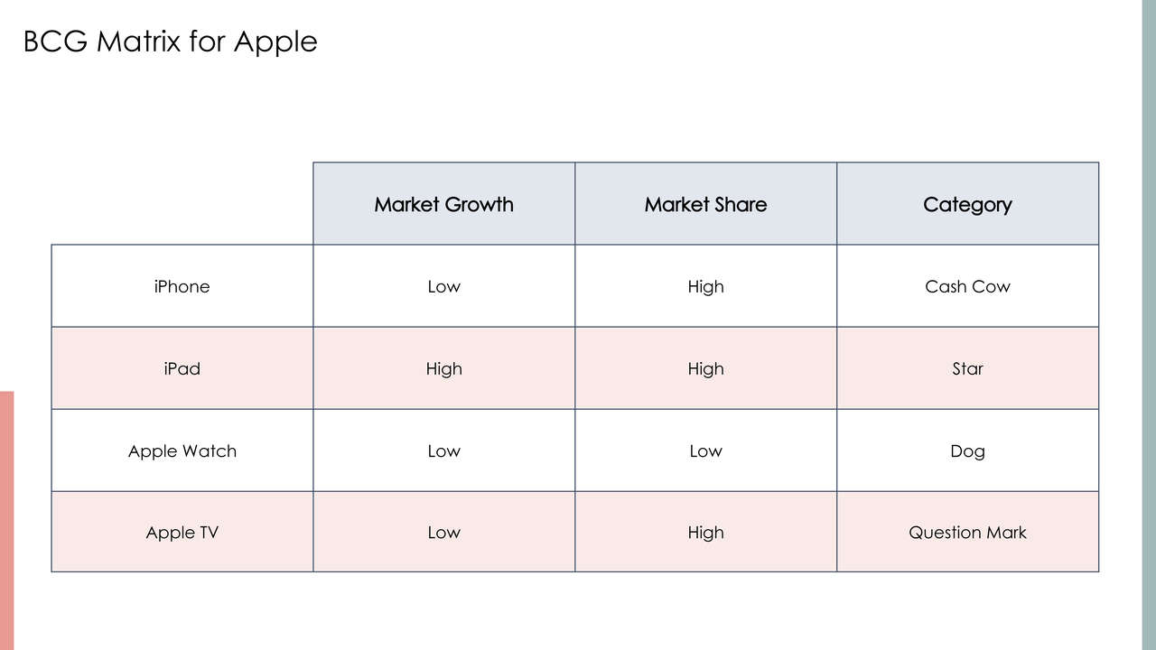
Go, change the world
RV College of
Engineering

Slide 8

Go, change the world
RV College of
Engineering

Slide 9
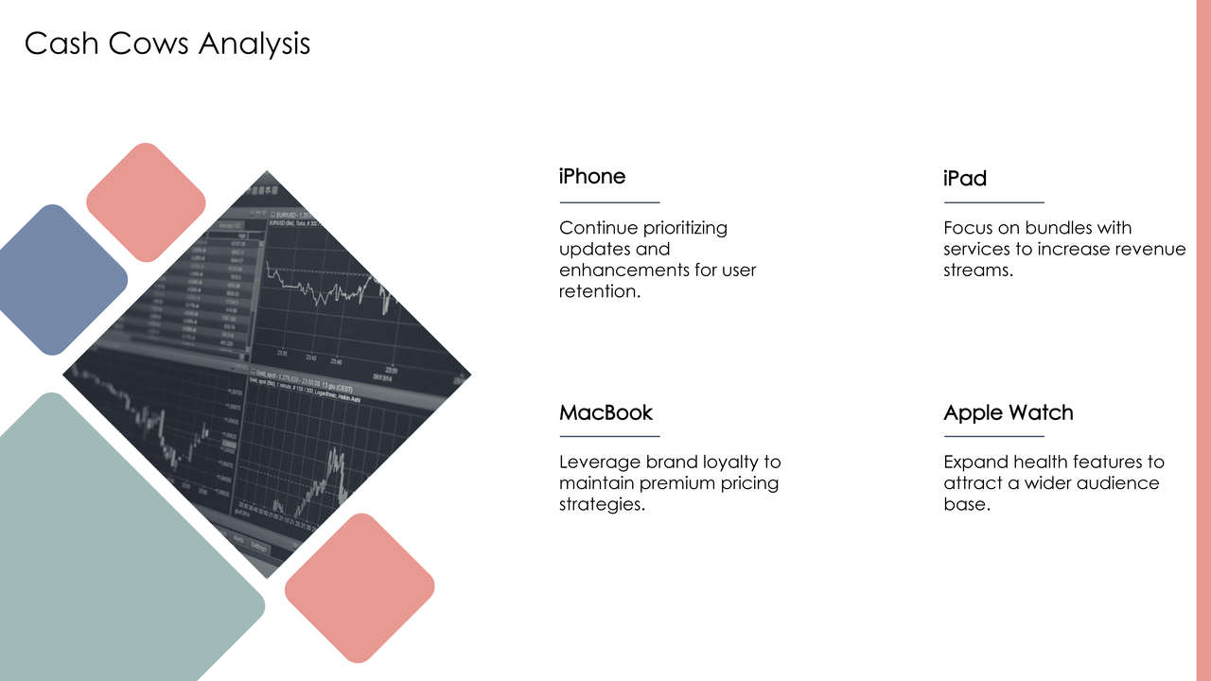
Go, change the world
RV College of
Engineering

Slide 10
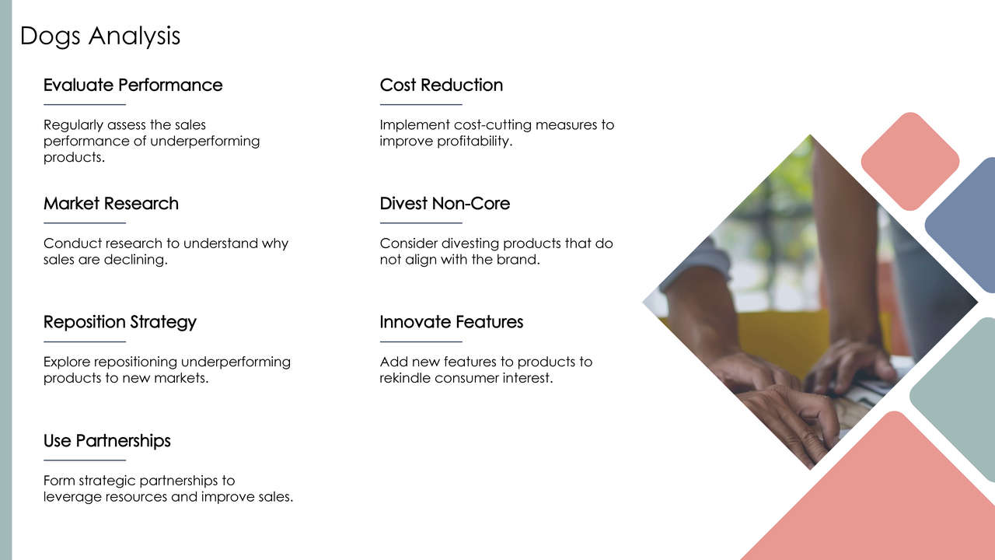
Go, change the world
RV College of
Engineering

Slide 11
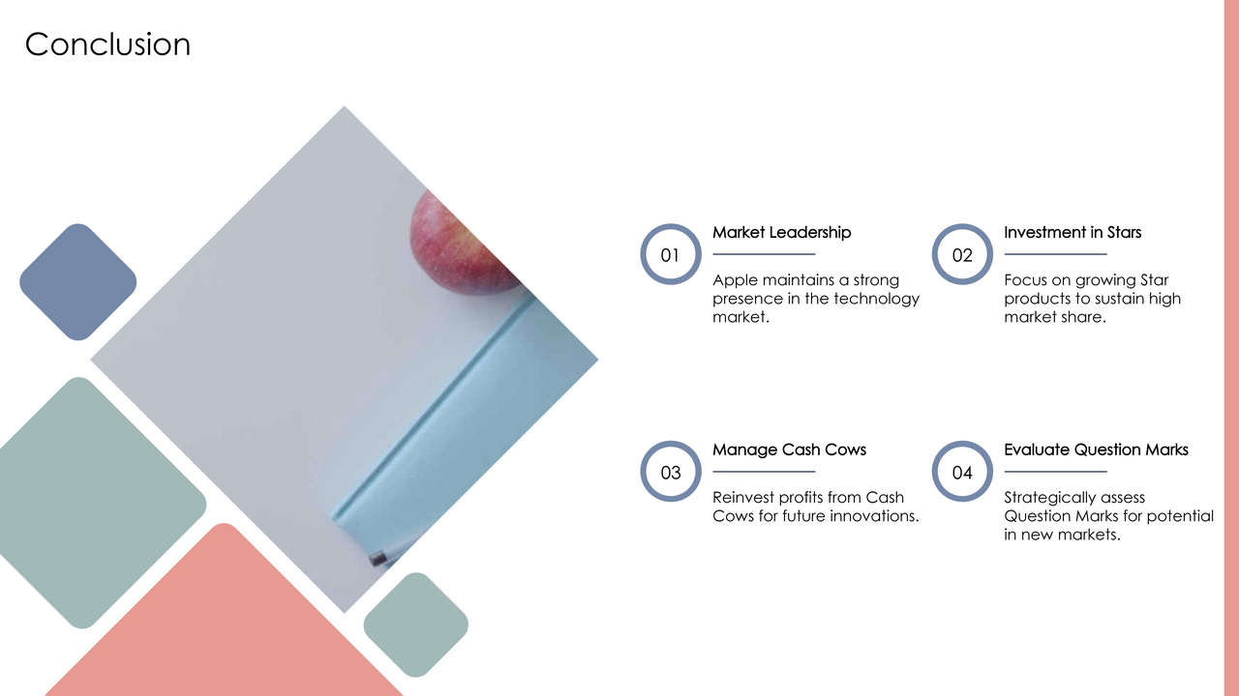
Go, change the world
RV College of
Engineering

Slide 12
THANK YOU
Go, change the world
RV College of
Engineering

Slide 13
Go, change the world
RV College of
Engineering

Slide 14
Go, change the world
RV College of
Engineering

